Slide 1
Introduction to Ember Js
Prepared By :- Jay Vaja (D22IT183)

Slide 2
Introduction
What is ember js?
Why to choose ember js
Key Features
Ember js vs React js
Installation
Code
CONTENTS

Slide 3
Introduction
Ember.js is a JavaScript framework for building ambitious web applications.
It is built on top of the popular jQuery library and provides a number of features that make it easy to develop complex and scalable applications.
Ember.js is based on a number of core concepts, including Model-View-Controller (MVC), components, and data binding.
Ember.js is a good choice for developers who are looking for a framework that can help them to develop complex and scalable applications quickly and easily.

Slide 4
What is Ember js?
Ember.js is an open-source JavaScript framework.
Created in 2011, it has evolved into a mature and robust framework.
Designed for building ambitious web applications.
Examples:- Discord, PlayStation, Freshdesk, Netlify, Mozilla, The Washington Post, NASA.

Slide 5
Why to choose ember js?
Convention over Configuration: Ember.js provides sensible defaults, reducing the need for boilerplate code
Productivity: Faster development with Ember CLI (Command Line Interface)
Strong Community: Active community support, rich ecosystem, and frequent updates
Stability: A commitment to long-term stability and backward compatibility

Slide 6
Key Features
Routing: Ember.js provides a powerful routing system for managing application URLs
Components: Reusable UI building blocks that encapsulate behavior and style
Data Management: Ember Data for handling data models and API communication
Testing: Built-in testing tools and conventions for writing reliable tests

Slide 7
Ember js vs React js
Feature | Ember js | React js
Type | Full-featured framework | Library
Opinionated | Yes | Less opinionated
Routing | Build in | Not built-in, but there are many popular routing libraries available
Templating | Build in | Not built-in, but there are many popular templating libraries available
Data management | Build in | Not built-in, but there are many popular data management libraries available
Community | Large and active | Large and active

Slide 8
Installation
Download Ember js in your system
npm install -g ember-cli
Create Ember js project
ember new your-project-name
Navigate to Project Directory
cd your-project-name
Start Project
ember serve/npm start
This will compile your project, start the development server, and provide you with a local URL where you can access your Ember.js application. Typically, it will be something like ‘http://localhost:4200’.

Slide 9
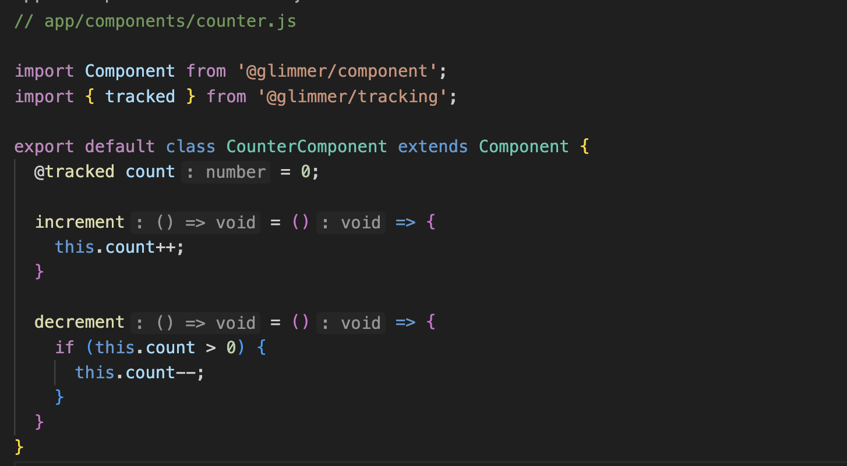
Code
In Ember.js, @glimmer is a reference to the Glimmer.js rendering engine, which is used for handling the rendering and updating of user interfaces. Glimmer is a core part of Ember.js and is also used in other JavaScript frameworks like the standalone Glimmer.js framework and parts of the Ember ecosystem.
@glimmer/component is an import statement that allows you to use Glimmer components in your Ember.js application.
Similarly, @glimmer/tracking is another import statement that brings in functionality related to tracking changes in state.

Slide 10
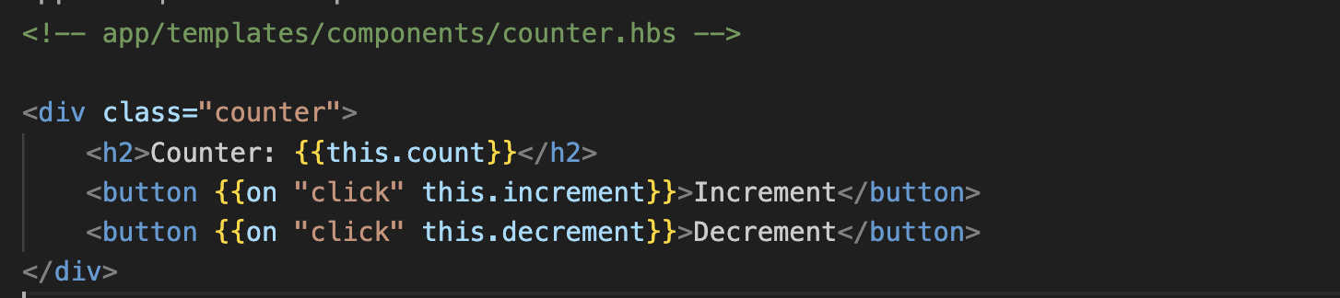
Code

Slide 11
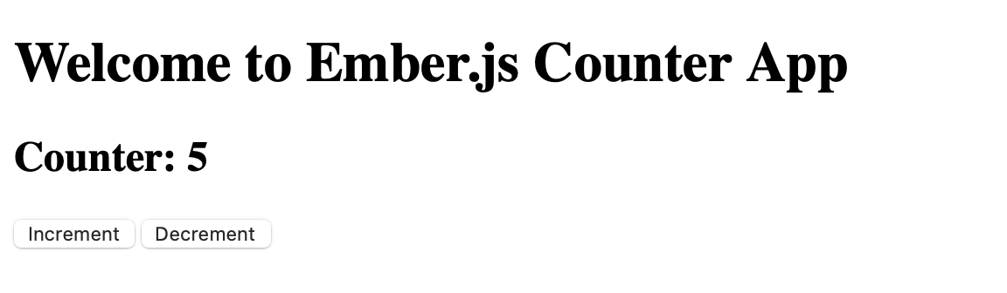

Output

Slide 12
THANKS

